Slide 1
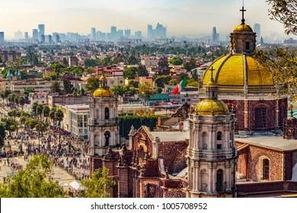
If you could go anywhere in the world, where would you want to go?
Notes:
I was thinking we could change the opening of the PPT, we can also keep it the same as last year too!

Slide 2
Are you interested in English?
Yes!
I love English!
Notes:
I was thinking we could change the opening of the PPT, we can also keep it the same as last year too!

Slide 3
You can use your English to make your dream come true!
Really?
How?
Notes:
I was thinking we could change the opening of the PPT, we can also keep it the same as last year too!

Slide 4
Introducing…

Slide 5
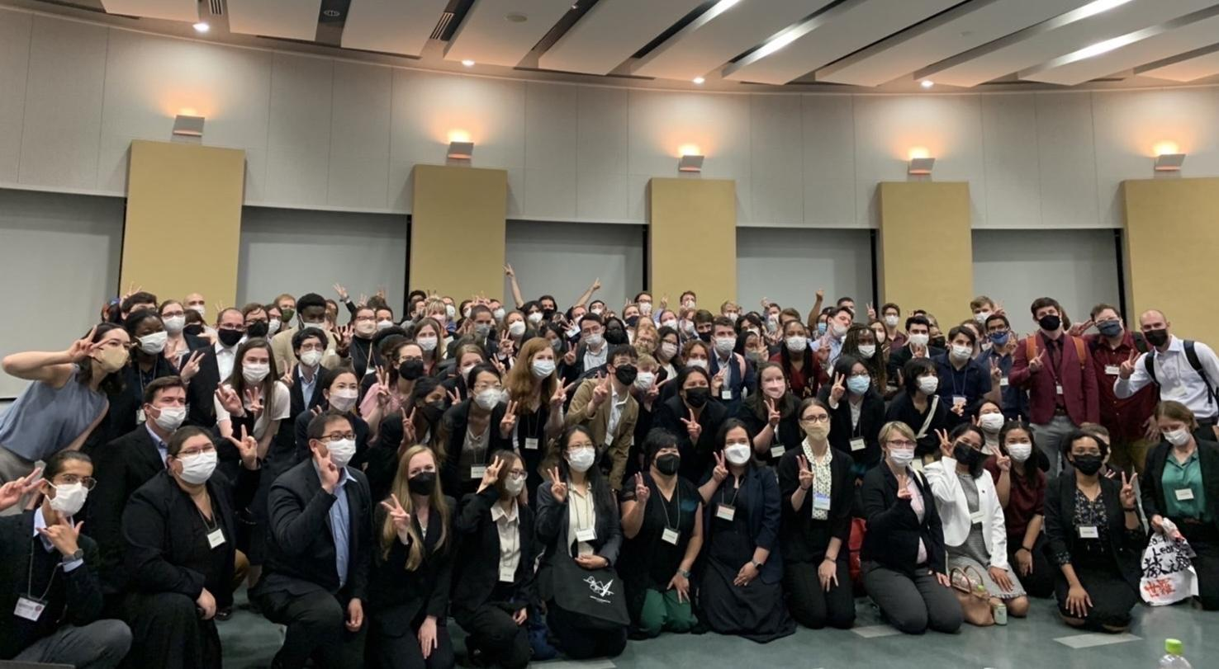
Who are we?
We want to help students study abroad and
We are the ALTs
of Hiroshima!

Slide 6
What is the HJSF?
A scholarship where you can win free money and use it to study abroad!
One student will win
!!!
¥ 250,000

Slide 7
Who can apply?
Any student in year 2 or 3 of Junior High School
Any student in year 1 or 2 of Senior High School
at a school in Hiroshima Prefecture with a JET ALT.

Slide 8
How to apply:
Get an application
Fill out the app in English
Ask your ALT
Go to
hjsfund.org
Send it all to the Scholarship Committee
Ask your teacher for a letter of recommendation

Slide 9
Application Deadline
October 31st, 2023
Interview dates chosen
November
Interviews
December
Winner chosen
January 2024

Slide 10
For more information
Find the dog at your school!
Talk to your ALT!
or
Check out our website!

Slide 12
Make your dream come true!
Apply today!
Apply today!
Apply today!

